Slide 1
MealHero
App By DLTOne

Slide 2
About MealHero
MealHero will be the app that revolutionizes the way non-profit organization Meals On Wheels delivers food to the elderly in Florida! By using its advanced navigational algorithm, and its simple user interface, MealHero will assist volunteers to deliver meals to multiple locations fast, so no meal will get cold!

Slide 3
Current Problems
Ineffectiveness of printed out directions given to volunteers
Traffic & inefficient routes
Need of Medical & personal Assistance for some clients

Slide 4
MealHero’s Solutions
In app route delegation system to replace printed out directions for volunteers
Turn by turn navigation system to generate best routes for one or multiple delivery destinations, and avoid traffic
Location based information system to find nearby medical care facilities, elder care facilities, and transportation such as bus stops

Slide 5
Market Analysis
MealHero | ServTracker
Optimized Delivery Routes | GPS mapping
Nearby transportation/medical services | N/A
Personalized information logging for each client | Basic client information sheets
Smart Route Suggestions | N/A
Admin Route Delegation System | N/A

Slide 6
Target Market
Volunteers for Meals on Wheels, who will be using MealHero to navigate & deliver hot meals to clients.
Meals on Wheels owner or employees, who can assign routes to volunteers via admin accounts

Slide 7
Features
Route delegation system
Optimized Delivery Routes
Personalized information for each client
Information on nearby hospitals and bus stations, etc
Smart route suggestions
Minimalistic & easy to use UI

Slide 8
Minimalistic Design
MealHero’s UI is designed specifically for non-tech savvy users. its simple design, and beautiful graphics make it easier for volunteers from all age groups use MealHero to deliver food and assist the clients better!

Slide 9
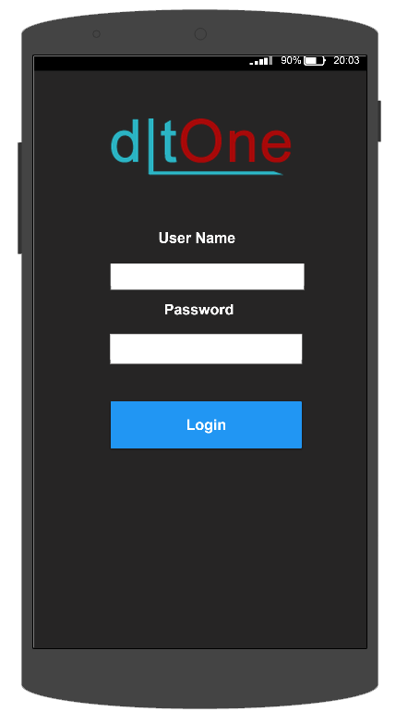
Usage Scenarios - Login
Users are presented with a login page, where they enter their credentials.
Notes:
Use case diagrams go here

Slide 10
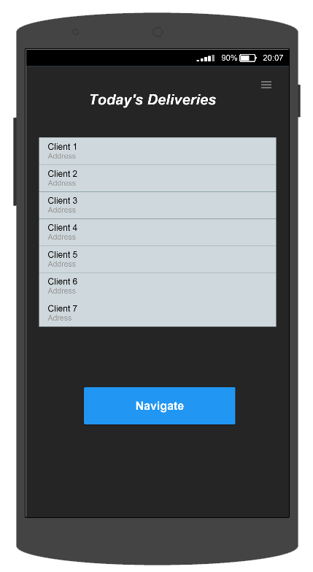
Usage Scenarios - Client List
Upon successful login, users are presented with a personalized list of assigned or chosen clients.

Slide 11
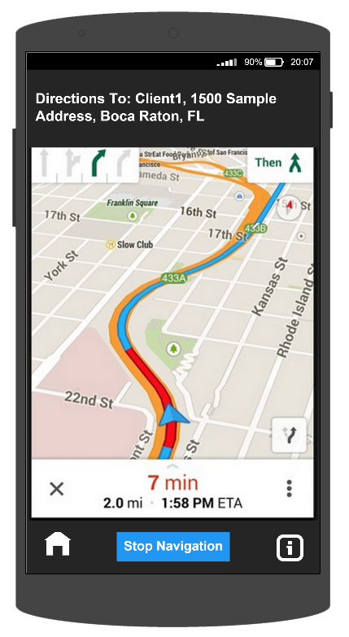
Usage Scenarios - Navigation
When ready to begin their route, users click Navigate.
This calculates the fastest route to all clients and brings the user to a real time GPS navigation screen.

Slide 12
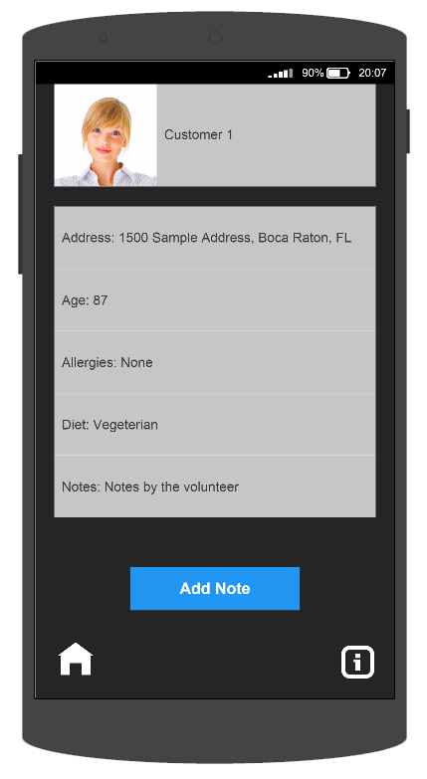
Usage Scenarios - Edit Client
Users will also have the ability to edit important client information such as:
Allergies
Diet
Medical Issues
Users will be able to add any notes containing other information about the client.

Slide 13
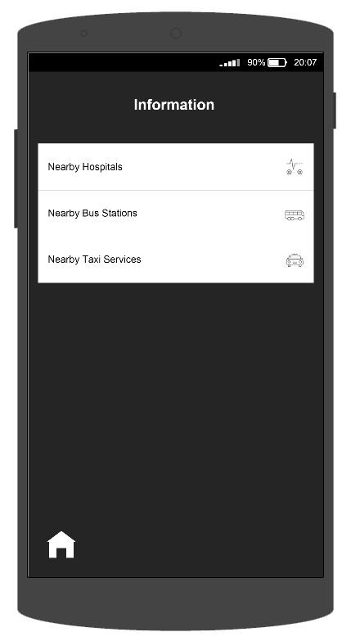
Usage Scenarios - Directory
Users have access to a Directory of nearby:
Hospitals
Emergency Care Centers
Bus Stations
Taxi Services
All without ever leaving the application.

Slide 14
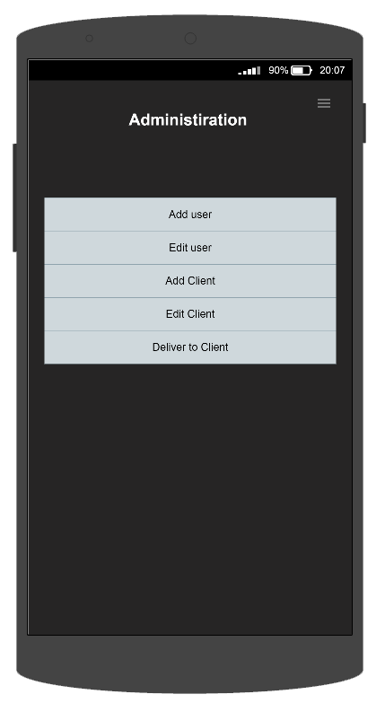
Usage Scenarios - Admin
When an administrator logs in, they are brought to the Administration landing page.
Here they can:
Assign routes to volunteers
Add new users
Edit existing users
Add new clients
Edit existing clients

Slide 15
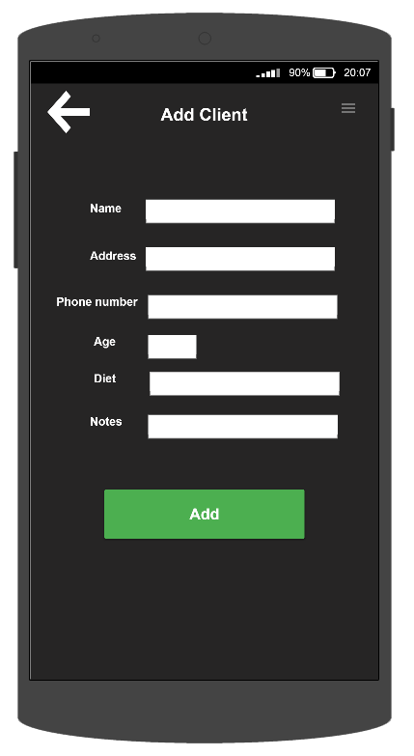
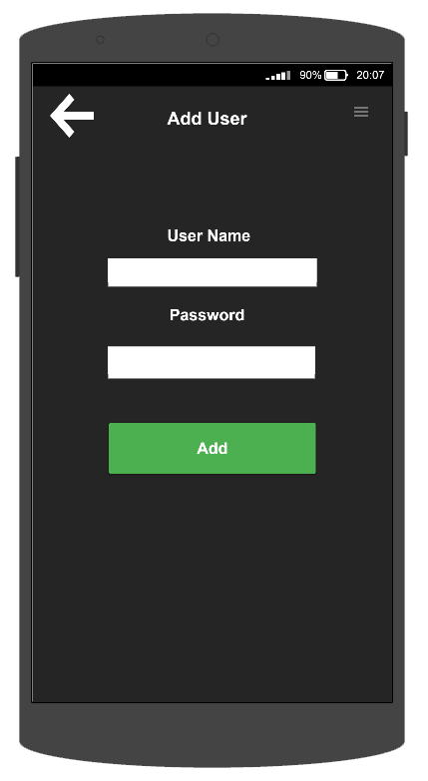
Usage Scenarios
Add Client Page
Add User Page

Slide 16
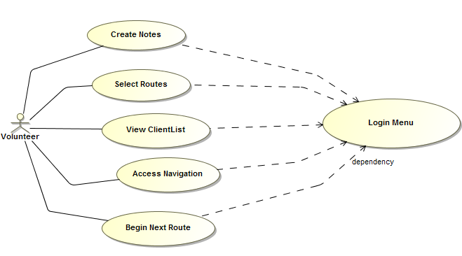
Use Case Diagram - Volunteer

Slide 17
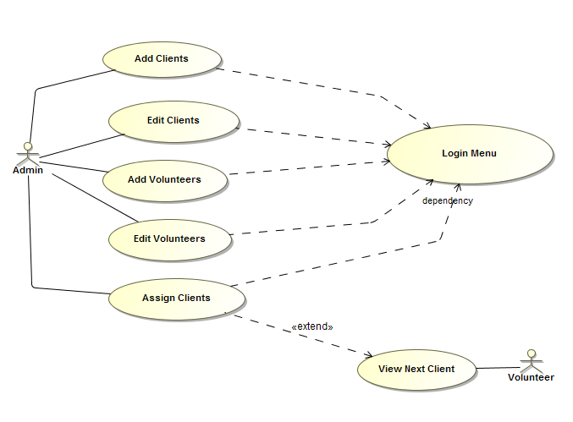
Use Case Diagram - Admin

Slide 18
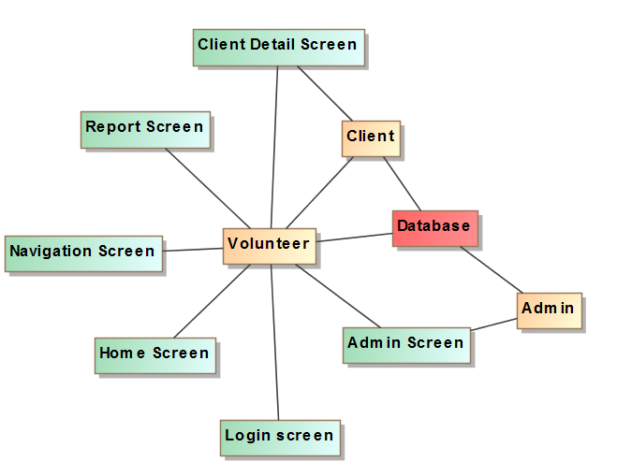
MVC Architecture

Slide 19
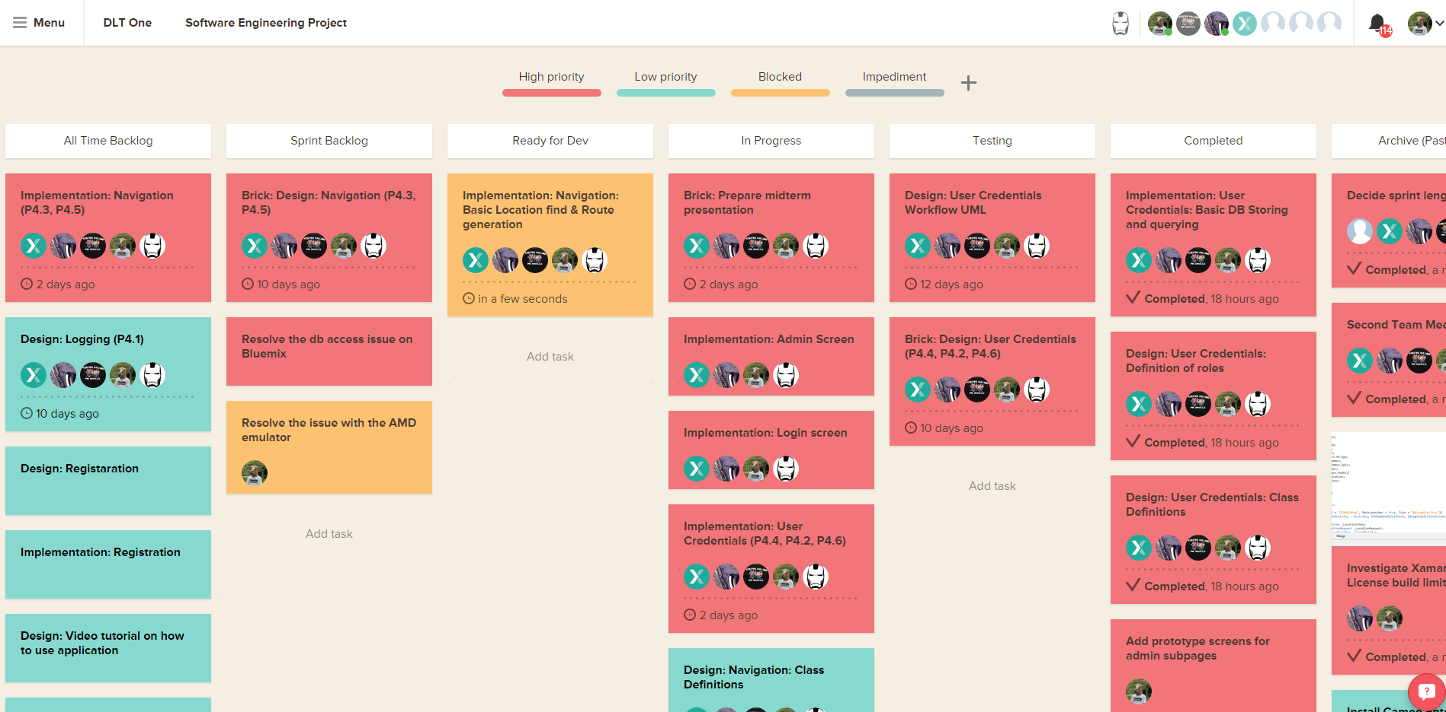
Backlog

Slide 20
What We Have Implemented so far
Login Screen
Secure password encryption
Volunteer and client database querying
Administration Screen
Client sync between volunteers

Slide 21
DLTOne Team contributions
Team member | Contributions
Washington Garcia - Product Owner | Setup Bluemix Worked on the code Worked on the design & architecture
Costin Denisov - Scrum Master | Worked on the code Worked on the powerpoint Worked on documentation
Shervin Shahrdar - Developer | Designed the MVC architecture of the app Worked on the code Created and worked on the powerpoint Worked on the documentation
Jevon Harriott - Developer | Worked on the code Worked on the documentation
Chanel Donald - Developer | Created the use case diagrams Worked on the documentation

